Slide 1

Growing Sustainable Vanilla in the US
Securing the Future of Vanilla

Slide 2
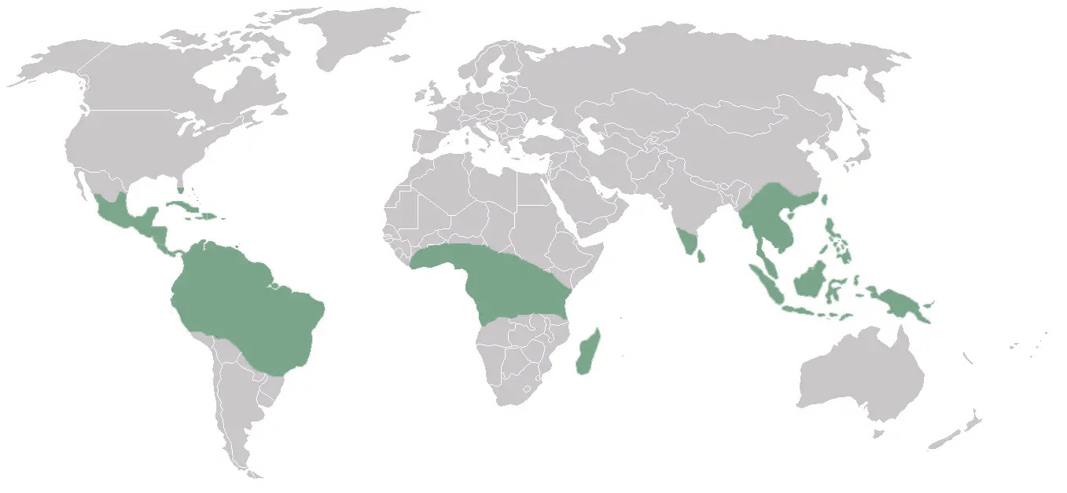
The Opportunity – Why Vanilla?
80% global support of naturally grown vanilla from Madagascar - unstable, labor-intensive, climate-vulnerable
Synthetic vanillin dominates the market (95%), but consumers demand natural, traceable, ethical ingredients.
US #1 importer in the world) with demand for naturally grown increasing significantly & rapidly.
Terra35 Proposition
Vanilla can be grown in controlled-climate environments- domestically, sustainably, and profitably.
We can stabilize supply quality and consistency and reduce price volatility.

Slide 3
Vanilla – By the Numbers
Global Market (annual worth) |  |  | US market (annual worth)
Vanilla Extract | $5.5 Billion (CAGR 6.2% to 2030) |  | Annual imports | $1.3Billion 90% Synthetic : 10% Natural (Natural is 100% imported)
Natural Vanilla | $923.3 Million |  | Natural Vanilla | $131.7Million CAGR 5.66% to 2032 (80% from Madagascar)
Organic Vanilla | $461.5-$794.5 Million* CAGR 8.8-17.2% ($1.4-1.43Billion by 2034) |  | Organic Vanilla | $115.15Million CAGR 13.6% ($468.86M by 2035)
* Range due to different calculation methodologies in different sources

Slide 4





Terra35 - What We Care About | How We Operate
We grow vanilla sustainably, agnostic of geography. Close to the product’s commercial market.
Our Purpose is to foster economic growth while minimizing environmental impact, reducing climate change impact, and prioritizing resource efficiency through reuse and recycling.
Our Priority 1 : To Future Proof Vanilla and Bend the Climate Change Curve.
We leverage existing space- small footprint & limited land use
Private/ Academic collaboration - grow, Research & innovate
Hybrid Investment –
state and private
Tech-enabled climate control - Closed loop sustainable grow
Scalable & repeatable
How?
Notes:
Science matters – we push academic institutions to create generational knowledge & innovate growing sustainably

Slide 5
Our Business Model
Revenue Streams (with vanilla extract, paste & powder sold via wholesale B2B)
Terra35 indoor grown vanilla - premium price point (flagship)
Partner organic cured beans (US preferred), Terra35 extracted
Terra35 natural premium vanilla via cellular agriculture
Unit Economics
Low asset ownership, high vanilla value & margin where we develop full supply chain
Cellular agriculture offers the opportunity to expand the natural market share with a price point to compete with the synthetic market
Partnership Potential
Co-investment or profit share for asset share (with growers or extractors)
Examples: Grow in previous indoor cannabis grow sites; Agrivoltaics with renewable energy companies & academia

Slide 6
Terra35 Founders
Tanya Thornton | Strategic Operator | Efficiency, Scale & Change Management Leader
Meagan Gleason | Strategy, Product Innovation & Development Leader
Meagan is a mission-driven entrepreneur with 30+ years in business strategy & product innovation. She’s launched and scaled ventures across startups, nonprofits, and Fortune 500s, blending data, design, and impact.
Meagan holds a BA in Political Science and a graduate program in Sustainability from MIT.
Tanya holds an MSc in Geology and a graduate program in Sustainability from MIT.
Tanya brings 30+ years in business experience across the energy and tech industries, including 24 years at Microsoft in global tech engineering and operations, scaling multi-billion-dollar platforms like Azure and Microsoft 365. She specializes in aligning people, process, and technology to build efficient, scalable, high-impact systems.

Slide 7
Our 3-Pronged Strategy
1
Operate Lean, Stay Sustainable
Minimal asset ownership until first crop success
Leverage partnerships for infrastructure, processing & services
Capital-efficient, mission-aligned model
Crawl, Walk, Run
Early partnerships with sustainability-minded growers & processors
Build customer base while generating cash flow
3 revenue streams = faster path to value, lower risk
Data-Proven Blueprint → Scale
Nail data-driven grow & process protocols
Lock in operational blueprint
Scale what’s proven to work
2
3

Slide 8
The Terra35 Team
Board of Directors
Core Team
Tanya Thornton
Co-Founder
Business Development & Operations
Meagan Gleason
Co-Founder
Business Development & Product Innovation
TBC
Lead Scientist
TBC
Partner Relationships & Regulations
TBC
Contracts, Legal Counsel
TBC
Chief Financial Officer
TBC
Storytelling Lead – Comms - PR
Professor. Olivier de Weck MIT Apollo systems lead, Systems Engineering master.
Dr. Afreen Siddiqui MIT systems engineer, Harvard Fellow, Sustainability & Food Security Policy Global Consultant.
Dr. Xingbo Wu – Vanilla Cultivation Expert, Academic Leader.
Dave Benson – Infrastructure Engineer, Investor
Dave Scholin – Cell tissue biotechnologist, Strategic Partner
Mike Buckley – Controlled environment farming expert, Finance leader.
Strategic Partnerships
Grow & Produce
Partner& Produce
Make & Produce
Climate controlled vanilla cultivation indoors in USA
Partner-grown cured vanilla + Terra35 production in USA
Terra35 grown natural vanillin (cellular agriculture) in US
Washington State University Horticulture – Prof Matt Whiteley, Dr Troy Peters
Oregon State University Horticulture – Prof Lloyd Nackley
Oregon State University Solar Energy – Dr Chad
University of Florida – Dr. Xingbo Wu (Vanilla Genetics & Grow Expert)
Oregon Food Innovation Lab
CEA Oregon Group (non-profit) – Rebecca Knight
Rheaplant- CTO Derek Scholin.
Grow partnerships with existing PNW cannabis growers
Cure & Extract partnerships with US service providers (outsourced) (Yr 1-3)
Terra35 Cure & Extract vertical integration (Yr 3+)
USDA certified Organic White Label partnerships with US service providers (outsourced)
Terra35 wholesale product
Terra35 natural vanillin cell tissue culture with biotechnology partner.
Terra35 Product Innovation & Development Partnership
Terra35 wholesale product
Distribution
Pick & Pack Service Provider (outsourced)
Distribution Service Provider (outsourced)

Slide 9
5-Year Growth Plan
Year 1
Foundation & Focus
Launch with outsourced extraction product
Plant & start deep R&D: cultivation, curing, compliance
Secure 2–3 PNW anchor customers
Cash flow via lean ops, learning, & sales
Build digital brand & sustainability story
Year 2
Grow & Optimize
Scale production with grow partnerships
Blend outsourced + in-house extraction
Launch nursery, waste-to-dollars & refill programs (cuttings & waste to dollars = new revenue; refill = circularity)
Strengthen brand equity & customer base
Assemble contract team, prep for funding
Year 3
Expand & Solidify
Secure VC investment for grow facility expansion
National brand push: media, events, storytelling
Add core leadership team (cultivation, tech, sales)
Launch cuttings sales nationally
Finalize scalable blueprint
Year 4
Full Vertical Integration
First full Terra35-grown harvest + product launch
PR milestone: first indoor-grown U.S. vanilla
National distribution + customer acquisition
Add extraction/curing leads & green infrastructure
Target cash flow break-even
Year 5
Lead & Scale
Scale national supply chain to meet demand
Expand to new grow regions via blueprint
National nursery program fuels partner growers
Achieve full circular ops: renewables, water reuse, zero waste
Profitable, self-funding, nationally recognized leader

Slide 10
What We Are Working On - What We Need Now
Co-funding for R&D, grow operations build out, extraction build-out
Private investment
State/Federal US Government : Innovation grants, rural economic development incentives, small business grants, women owned businesses.
Partnerships
Business Oregon
Food Innovation Center – Oregon State University
University Researchers & Expertise (Washington State University, Oregon State University, University of Florida)
Regional US Growers and Co-Ops
US Customers - Food and flavor companies for pilot contracts
Renewable energy companies (Solar, Wind)

Slide 11
Appendix
Terra35 System
Analysis – vanilla lifecycle: outdoor vs. indoor grow
Vanilla value Chain

Slide 12
Terra35 System - Cultivate to Extract to Sell
System Boundary
External to System
Business Operations component
Investors
Scientific/ Advisory
Board
Terra35 Company
Board
Human
Capital
Academic Partnerships
Municipal Electricity
Municipal Water
Growing facility
HVAC/
Heat
Irrigation/ Water
Renewable energy creator
Cloud service &
data centers
Certification Partners
Infrastructure component
Academic Research Facility
Growing Experts
Plants
Tech systems to monitor & control environment
Water recycling system
Academic Research Collaborations
Buyers - Vanilla
Product Finalization component
Organic Waste Recycle Partners
Buyers – Vanilla growing waste
Curing apparatus
Curing Facility
Extraction apparatus
Extraction facility
Packaging for distribution
Distribution component
Distribution networks
Expected System Outputs
Vanilla Product (Wholesale)
Buyer Purchase Behavior Change (Synthetic -> Natural
market share)
Commercialization component
Public Engagement (Comms, PR)
Product branding & marketing
Sales engagement
Scalable, repeatable Blueprint - economically viable, sustainable, low CO2 impact farming
Engaged Buyers – vanilla and vanilla waste
Regulatory Compliance
Partner relationship management
Circular Economy- renewable energy, zero waste AND Secondary Revenue
Geographically independent growing is proven

Slide 13
Vanilla Lifecycle – Tropical Outdoor vs. Indoor Grown
Stage | Stage Focus |  | Time Window (Tropical) | Environmental Conditions (Tropical) |  | Time Window (Greenhouse) | Environmental Conditions (Greenhouse)
Propagation | Rooting of cuttings, establishment |  | 3-6 months | Warm, humid, shaded (70-85% shade), 25-30°C |  | 3-4 months | Controlled temperature (24-28°C), 70-85% humidity
Establishment | Initial vine growth, support setup |  | 6-12 months | Partial shade, 60-70% humidity, 25-30°C |  | 4-6 months | Controlled shade (60-70%), 24-28°C, humidity control
Vegetative Growth | Vine elongation, trellising |  | 1-3 years | Partial shade, 24-30°C, 70-85% humidity |  | 12-18 months | 24-28°C, 70-85% humidity, optimized nutrient supply
Flowering Induction | Flowering initiation, pollination management |  | Seasonal (Usually Spring) | 20-25°C at night, 25-30°C day, 60-70% humidity |  | Induced year-round | Controlled temp shifts to 18-24°C at night, 25-28°C day
Pollination | Hand pollination, setting pods |  | 1-2 months | 20-30°C, moderate humidity (50-70%) |  | 1-2 months | 22-26°C, humidity controlled (55-70%)
Pod Development | Pod maturation, nutrient supply |  | 8-10 months | Warm (24-30°C), humid (70-85%), consistent moisture |  | 6-8 months | 24-28°C, 70-80% humidity, optimal nutrient delivery
Harvesting | Optimal pod ripeness, harvesting |  | Seasonal (8-10 months after pollination) | Warm, dry (25-28°C), 70-80% humidity |  | 6-8 months post-pollination | 24-28°C, controlled drying and curing areas
Curing | Flavor development, drying, fermentation |  | 3-6 months | Alternating sun-drying and sweating (40-50°C) |  | 2-3 months | Controlled drying (40-50°C), humidity control
Storage | Preservation of flavor, moisture content |  | Up to 2 years | 15-20°C, 50-65% humidity, dark storage |  | Up to 2 years | 15-20°C, 50-65% humidity, airtight storage

Slide 14
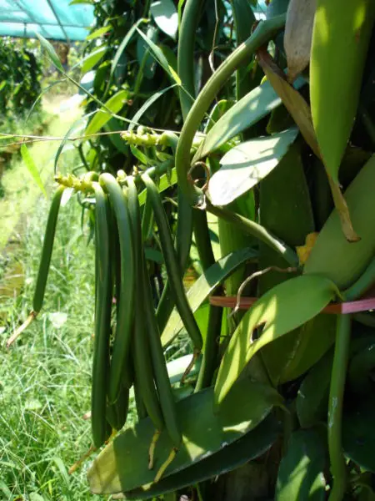
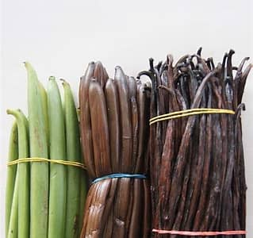
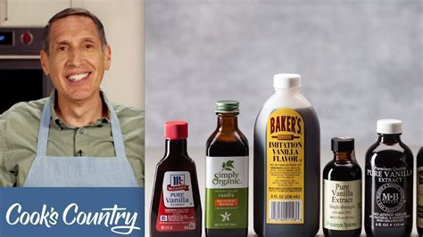
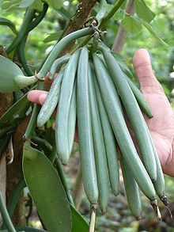
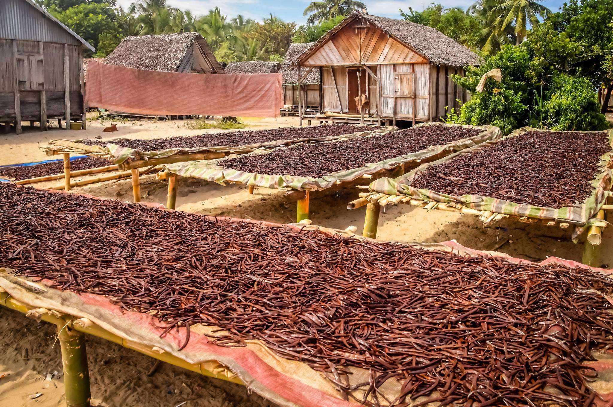
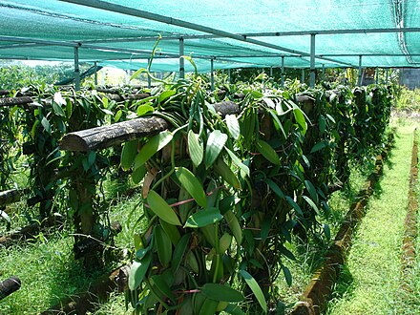
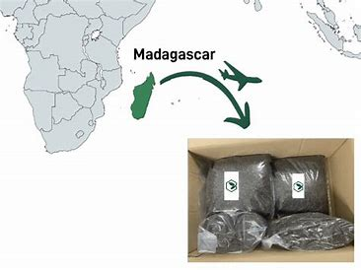
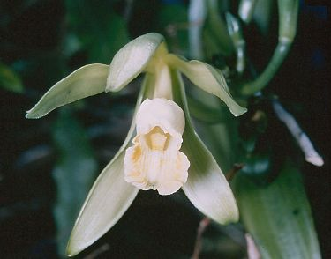
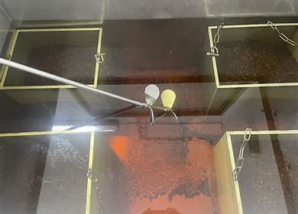
Traditionally Grown Natural Vanilla - Supply Chain Value Journey
Once the vine flowers, it must be pollinated within 12 hours to bear fruit. The result is green vanilla bean pods. They may be sold at this stage.
Alternatively curing can be completed through fermentation, sweating and slow drying/ dehydration which develops the flavor profile aligned to curing process selected.
Vanilla extract, paste and powder can be created post curing. These become vanilla products that are sold as ingredients for integration into other products such as ice cream or pastries.
Curing can be complete by drying pods in the sun.
Vanilla grows in vines with 2.5-3.5 years maturation timeline before producing first fruit. It can produce annually thereafter.
Producers also buy cured vanilla beans and create products themselves for sale to consumers at retail.
Exporters ship cured beans globally
Supply Chain Stage | Price (per kg) | Description |  | Profit distribution
Farmgate | $3.30-$24 per kg (7kg green beans | 1kg retail vanilla) | Assumes Madagascar outdoor grown vanilla |  | ~26%
Cured | $50-70 | Price post curing handled by processors. Includes drying, sweating, conditioning, grading, packaging |  | 47%
Exporter | $50-100 | Price exporter receives for cured beans. Subject to quality, volume, contracts and unofficial price controls
Importer | $28-290 | US importers buying and handling duties, inspection, warehousing costs |  | ~15%
Wholesaler | $106-200 | Often sold in bulk to manufacturers and gourmet suppliers
Retailer | $400-600+ | Typically commands $10-30 per vanilla bean (1.5-2g each) |  | ~12%

Slide 15
Working Slides (not to be included in pitch deck sent to others)

Slide 16
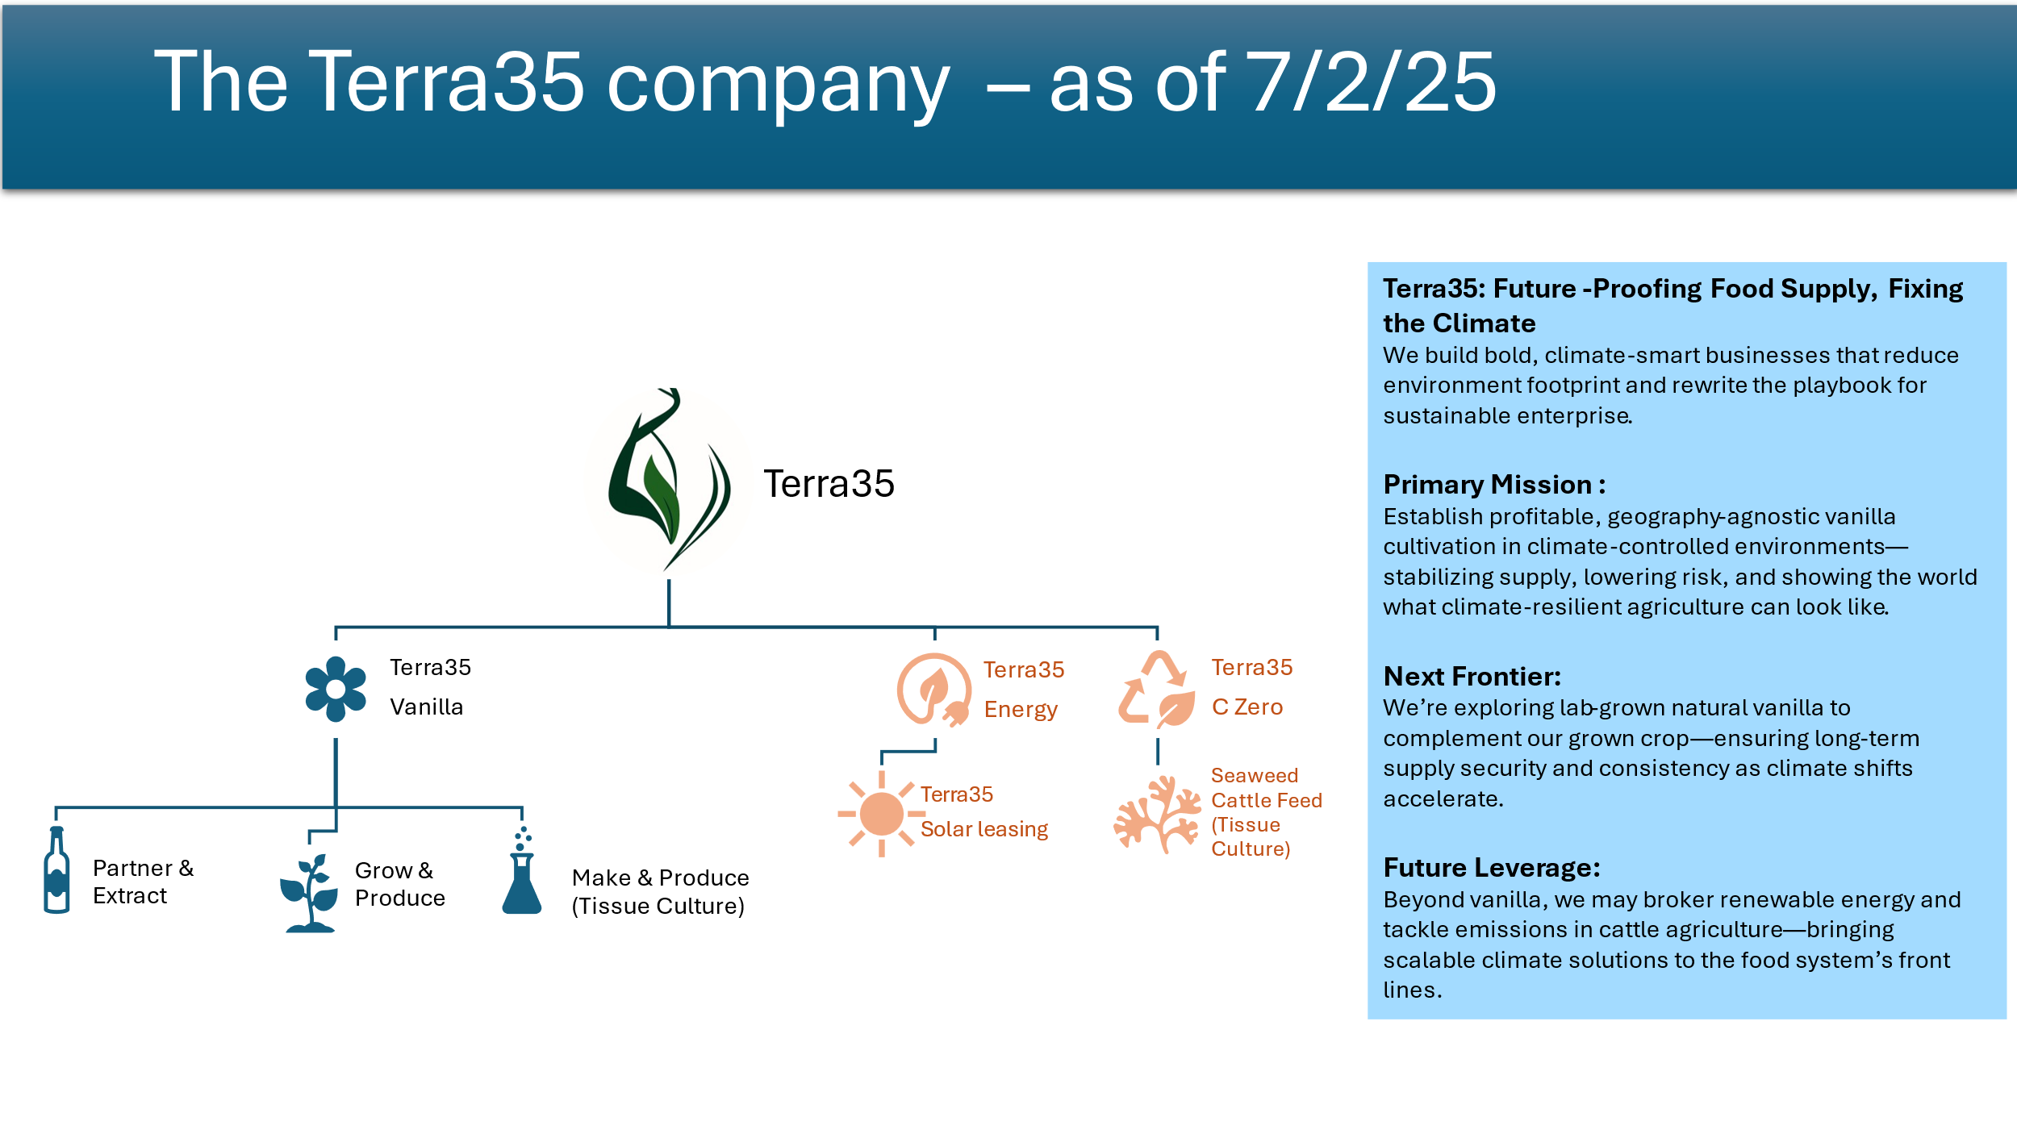

Slide 17
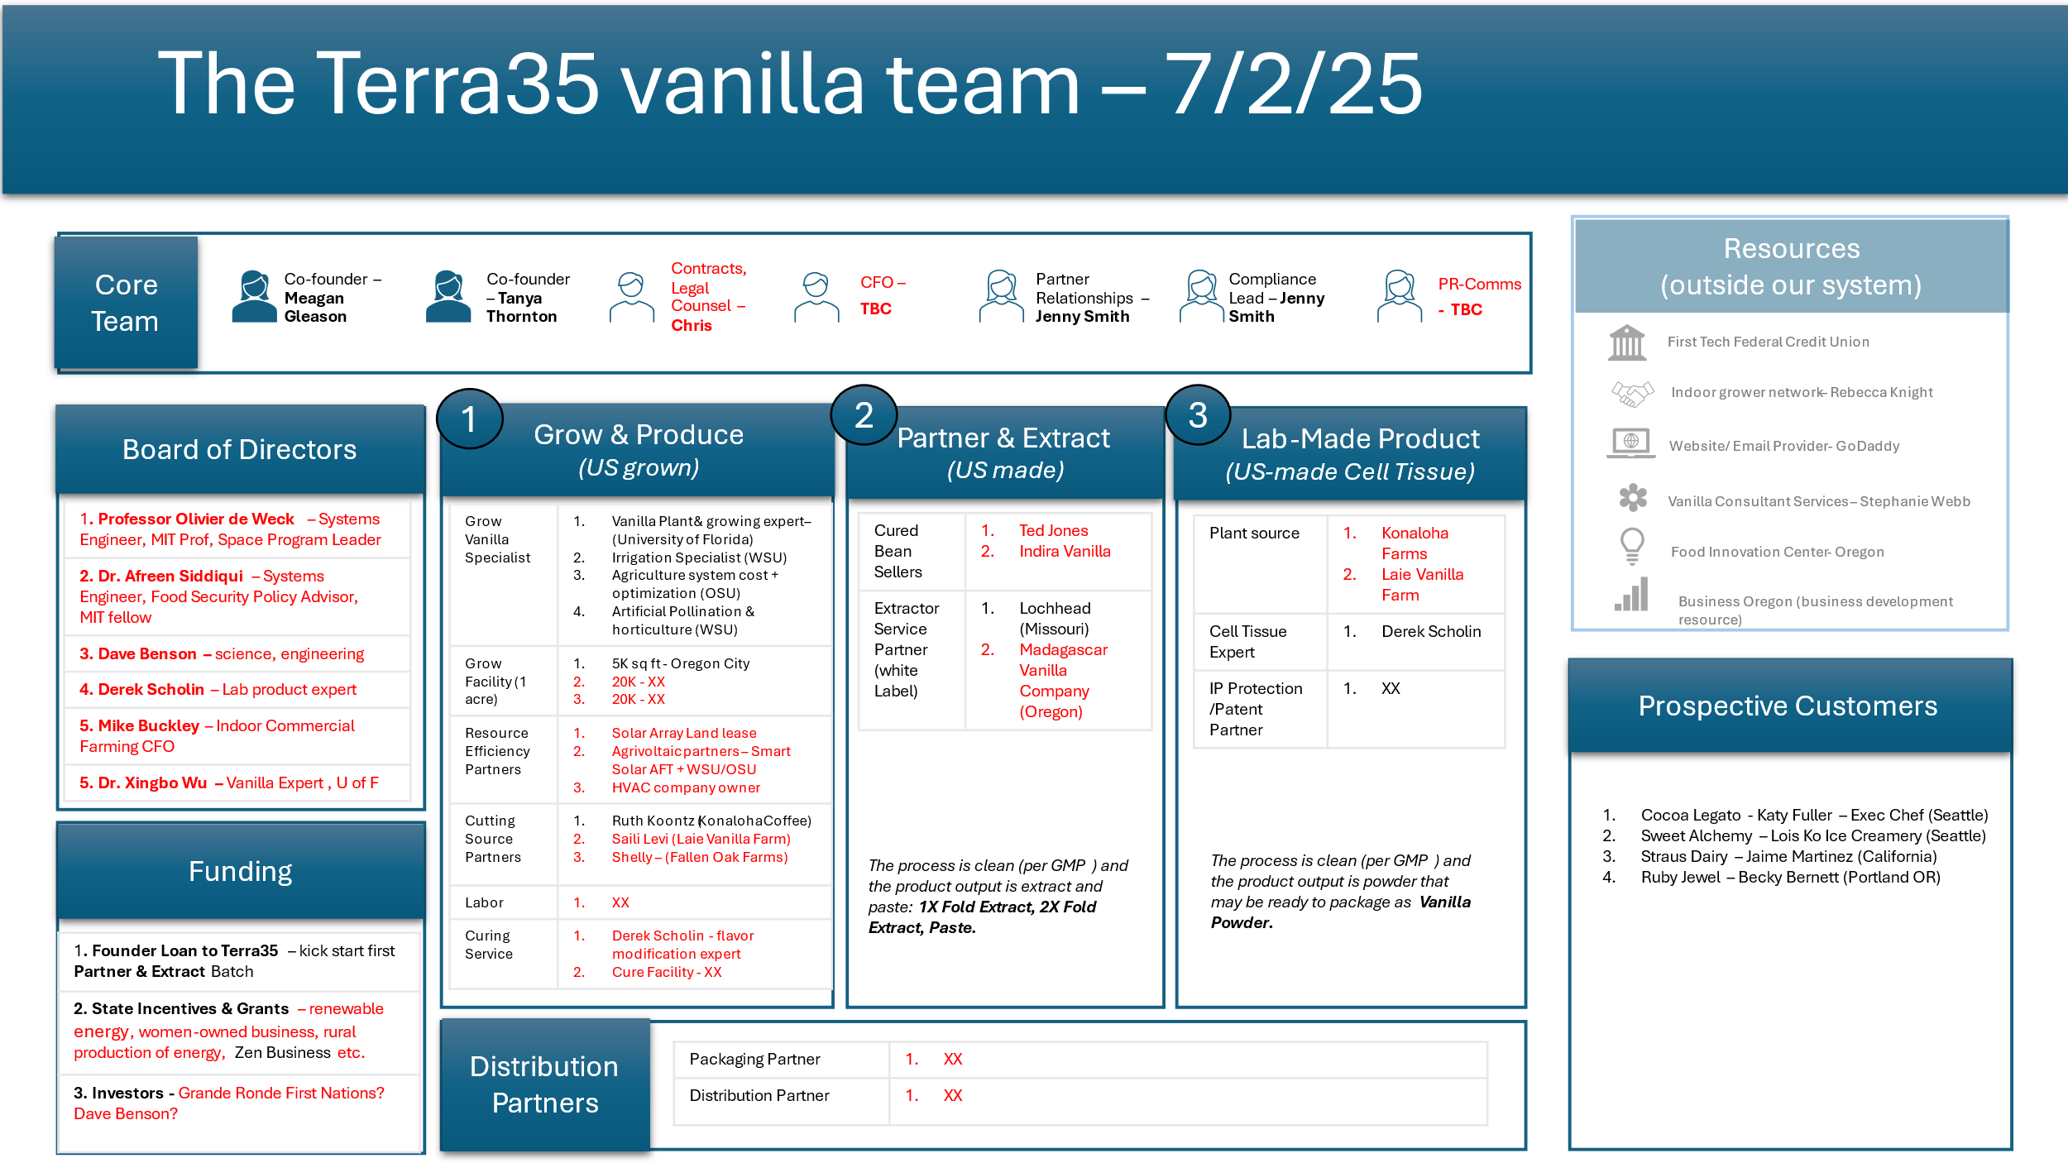

Slide 18
Vanilla Lifecycle –tropical location, traditional outdoor farm
Lifecycle | Plant | Establish and Vegetative Growth | Flowering | Pod Development and Maturation | Harvesting | Post-Harvest Curing
Time | 0-12 months | 1-3 years | 3 - 4 Years | 4 - 5 Years | 4.5 - 5 Years | 5 - 5.5 Years
Time window | Seedlings or cuttings are planted in the rainy season to ensure sufficient moisture. | Initial vegetative growth occurs for 18-36 months, with vines reaching 10-15 feet. | Vines flower annually, typically after the third year, during the spring or early summer. | Vanilla pods take 9-12 months to mature after pollination. | Harvesting occurs when pods are fully mature but not split, typically 9-10 months after pollination. | : Curing lasts 4-6 months with several stages: Killing: Pods blanched in hot water for 2-3 minutes Sweating: Pods wrapped in cloth and kept in a warm, dark place for 7-10 days Drying: Pods are sun-dried for 4-6 weeks to reduce moisture content Conditioning: Pods are stored in wooden boxes for 3-4 months to develop aroma and flavor
Environmental conditions | Temp: 77-86°F Humidity: 80%+ Shade: 50-60% (under partial canopy) Soil: Well-draining, loamy soil rich in organic matter, pH 6-7 Support Structures: Vines require support such as trees, posts, or trellises | Temp: 77-86°F Humidity: 85-90% Irrigation: Regular watering, especially during dry spells Pruning: Regular pruning to manage vine length and encourage flowering | Temp: 77-86°F Humidity: 85-90% Shade: 50% (ensure adequate light penetration) Pollination: Manual pollination is required within 12 hours of flower opening due to the short pollination window | Temp: 77-86°F Humidity: 85-90% Irrigation: Regular watering without waterlogging Monitoring: Pods should be monitored for signs of maturity — they turn yellowish at the tips when ready | Pods are handpicked when they reach full size (6-10 inches) and the tips begin to turn yellow | Sweating : Warm environment (per other stages) Dark place for 7-10 days to sweat

Slide 19
CEA Case Study Learning from others - Plenty’s bankruptcy
From 2014-2022 $940M was raised in multiple funding rounds – big support from tech, retail and agriculture
Seed and Series A (2014-16) $26M [Innovation Endeavors, Data Collective DCVC, Finistere Ventures]
Series B (2017) $200M [led by SoftBank Vision Fund 1, contributed to by Bezos Expeditions, Innovation Endeavors]
Series C (2019) $175M [led by SoftBank Vision Fund 1, participation from Eric Schmidt (via Innovation Endeavors), Bezos Expeditions]
Series D (2020) $140M [led by SoftBank Vision Fund 1, participation from JS Capital, One Madison Group. DLD Ventures (Driscolls)]
Series E (2022) $200M [led by One Madison Group and JS Capital, participation from Walmart and SoftBank Vision Fund 1]
Funding allowed Plenty to scale R&D and launch its flagship strawberry farm in Richmond VA. However, the company struggled to meet expectations for profitability and commercial scalability. These issues are at the core of their current restructuring strategy.
First sign of trouble in 2022 and 2023 after Series E. Plenty’s rollout to retail was slower than expected and their vertically integrated model became expensive to maintain. With rising energy prices and increasing infrastructure costs, questions rose about sustainability of the business model.
Many companies including Plenty struggle to scale profitably because of energy costs, infrastructure complexity and tightening investor confidence.
Emerging Agtech company models favor licensing and modular farming to mitigate the high capex model Plenty uses. Plenty has a vertically integrated, high capex model where they control everything from crop R&D to facility infrastructure – this enables innovation but brings high burn rates and operational strain.
Key lesson: You must balance rapid growth with operational sustainability.
Terra35 takeaway: Be asset lean until you’re making your own profit.

Slide 20
Terra35 Ecosystem
Role | Description | Possible People
Founders/ CEO | Business representation – public face Business strategy Secure investment in business Identify and engage partners to expand/improve business | Meagan + Tanya
Ops | Overseas E2E supply chain operations Defines & measures business metrics Optimizes for yield, operations efficiency & cost Plans for expansion in a repeatable, scalable way
Sales & Marketing | Engages with buyers – secure sales orders (pre-harvest) Establishes competitive advantage for company Strategizes to steal US market share from synthetic vanilla Builds brand and brand awareness
Growing/ Agronomy/ Research | Quality-Quantity-Efficiency Expertise in sensitive crops Expertise in irrigation efficiency Use tech to optimize environmental control & improve yield. | In-house Plant Scientist Academic Partners - OSU + WSU Professors & Research grads
Finance | Defines finance strategy Measures, tracks, optimizes & represents company financial health Runs financial rhythm & Financial standard reporting /comms Tracks economic trends and contribute to business strategy Supports securing & maintaining investment | Jenny? Dragos? Mike Buckley?
Role | Description | Possible People
Partnership/ Outreach | Evangelism Develop & foster relationships with partners Identify new partnerships aligned to business strategy | Jenny?
Evangelism/ Training | Ops Standards definition/ documentation / training Train staff | Jenny?
Comms/PR | Build and maintain digital presence Build communications strategy for consistency in brand and high brand awareness | Christine (Meagan friend) Kaley?
Legal Lead /Contracts | Deal structuring Legal Support & Regulatory Mgmnt. Contract management | Chris (Meagan neighbor)
Board | Contribute to business strategy Ensure compliance with regulation Identify risks & support mitigation Approve major expenditure Provide mentorship Assist with fundraising and exit strategy definition and implementation (e.g. IPO) | From investors & universities
Investors | Provide funding to set up infrastructure and run operations Advisor on board | State Grants + Incentives Private Venture Capitalists HVAC company owners Tribal Council

Slide 21
US Vanilla Market Big Buyers
Industry | Company | Location | Notes
Food & Beverage | McCormick & Company Symrise Inc Nielsen Massey Vanillas Givaudan SA International Flavors & Fragrances (IFF) | Hunt Valley MD 21031 Teterbo NJ 07608 Waukegan, IL 60085 Cincinnati OH 45216 New Century KS 66031 | 1. 2. & 3. Sustainability conscious vanilla programs + direct sourcing Madagascar
Baked Goods | Tripper Inc | Boulder, Colorado (distribution + US ops)
Personal Care | Symrise Inc International Flavors & Fragrances (IFF) | Teterbo NJ 07608 New Century KS 66031
Pharmaceutical | Givaudan SA | Cincinnati OH 45216
Industry | Company | Location
Agricultural processing & food ingredients production (Food & Beverage) | Archer Daniels Midland (ADM) | Chicago IL 60601

Slide 22
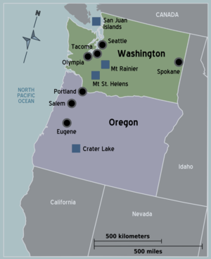




Potential Farm site locations
1
Oregon City, OR
2
Cascade Locks, OR
4
3
Tri-Cities WA
2
3
1
4
Vancouver WA

Slide 23

Contact Insights & Feedback
ACADEMIC PARTNER SYNERGY Vanilla and Tree Fruit have similar farming considerations & challenges. Good likeness – Prof Matt Whiting WSU
DEALS WITH PARTNERS Royalty Model with Vanilla Vida pretty standard. They must invest knowledge and cash upfront but get nothing back until we start making profit – Chris Kemper (Legal Eagle)
GROW HEALTH/YIELD Earthworm Casings mixed with water acts as a fantastic pesticide, fungicide and growth accelerator as well as delivering a bigger crop when used to water the plants - Dave (Cannabis Indoor Home Grower)
SYSTEMS WIDE STRATEGY Looking at E2E system is the right approach – multi-disciplinary approach needed as well as E2E system thinking – Prof Matt Whiting WSU
GROWING HEALTH /INFRSTRUCTURE
Irrigation Systems should be fairly simple for this (Flow valve) and scalable to vertical growing. No need for super high tech. – Dr. Troy Peters WSU
FINAL PRODUCT
Flavor Profile consistency from natural vanilla is a market differentiator particularly for the Food & Beverage industry – this is why they choose synthetic.

Slide 24
Comparables
Producers | Contact | Location | More details / Insights
Wageningen University | Tycho Vermeulen | Netherlands, EU | https://www.youtube.com/watch?v=KyCi4UB-Jjg Combine research with commercialization. Irrigation optimization is important for growing indoors to ensure there is no mold. Use geothermal energy.
Greenhouse Vanilla Farm | Abhinav Roy Abhinav@agriplast.co.in | India | https://www.youtube.com/watch?v=_qmjZhDAcA4&t=99s Hotter temps in summer than PNW so have to consider cooling systems. Temp control important. They use neem powder and charcoal for nutrition. Must be at root level. They use soilless media. They add bed plates to ensure the growing media stays deep enough. Bed width 3 ft, bed to bed distance 1.5 ft., plant to plant distance 1ft. bed is 5-6 inches deep.
Australian Vanilla Plantations + Schneider Electric (automation partner) | - | Australia | https://www.youtube.com/watch?v=AyMGeJ13A68&t=3s Innovative cultivation in dome greenhouse pods with circular vine structures and automation partnership. Plug and playing growing structures.
Discover Agriculture vertical indoor farming using hydroponics | www.discoveragriculture.com | India | https://www.youtube.com/watch?v=sfCxgpiqp0I&t=124s Vertical column vanilla cultivation with hydroponics = more intensive cultivation on circular trellises under shade structures - increases yields as planting density increases. Trellis support systems vary greatly but are generally made of vertical wood or concrete supports with a wire running between them. Supports vary in height but are usually no more than 2m or (6ft) tall to facilitate pollination once vines mature. The post and wire system allows for greater control over vine spacing compared to tutor trees. Vines will need to be maintained on 6 to 8 in of a mulch substrate.

Slide 25
Terra35 | Vanilla Vida – symbiosis opportunity
Vanilla Vida has a proven playbook in tech-driven vanilla farming within greenhouse environments.
Terra35 offers direct access to US market buyers, state and federal grants, local investors, and regional expertise — the ideal bridge to bring this model stateside.
Terra35 brings expertise in sustainable systems management, operational efficiency, data-driven tech solutions, and product development.
Our vision to localize high-value crops presents a compelling opportunity to partner in establishing a fully US-based operation for precision growing, curing, and flavor optimization.
Together, we can unlock a new standard for U.S.-grown vanilla—clean, resilient and market-ready.

Slide 26
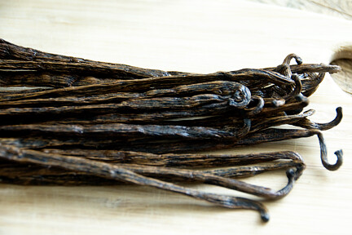
Curing Process & Equipment Costs
Curing Process
Equipment needs & costs
Killing* | Sweating* | Drying | Conditioning*
2-3 mins | 7-10 days | 2-3 weeks | 2-6 months
Halts vegetative growth & initiates enzymatic reactions. Typically, it involves blanching beans in hot water (~65°C) for 2-3 minutes | Promotes enzymatic activity and oxidation. Beans are kept in insulated boxes to maintain warmth and humidity for 7-10 days. | Reduces moisture content to prevent spoilage. Beans are sun-dried or placed in dryers until they reach about 25-30% moisture. This can take 2-3 weeks. | Beans are stored in closed boxes for several months (typically 3-6 months) to develop their full flavor profile.
Curing Equipment | Used for | Estimated Cost
King Son Vanilla Curing Chamber | Killing Sweating Conditioning | $20,000 to $50,000
Industrial hot air tray dryers | Drying | $3,000 to $4,800
Using equipment like the King Son Vanilla Curing Chamber can streamline and shorten curing time by providing controlled environments for each stage. It also eliminates issues such as unstable quality, variations and mold formation which can occur with manual processing.*
Industrial dryers are used primarily for the drying phase of vanilla curing. Zhucheng Tianshun Machinery Co., Ltd. offers industrial hot air tray dryers that are suitable.**

Slide 27
Natural Vanilla - Supply Chain Value Journey: Traditional vs. Greenhouse
Tropical outdoor farm
Supply Chain Stage | Cost to produce 1kg vanilla | Sale price after production | Margin | % return (Sell price- cost price)/Cost price) x 100 |  | Profit distribution across the value chain
Farmer (Green Beans) | $98 per 7 kgs (required to make 1kg retail vanilla) | $315 (7kgs) | $217 | 221.43% |  | ~26%
Curer | $315 | $875 | $560 | 177.78% |  | ~47%
Exporter | $875 | $875 | - | -
Importer/Wholesaler | $875 | $1,050 | $175 | 20% |  | ~15%
Retailer | $1,050 | $1,200 | $150 | 14.29% |  | ~12%
Greenhouse climate controlled vertical farm
Supply Chain Stage | Cost to produce 1kg vanilla | Sale price after production | Margin | % return |  | Profit distribution
Farmer (Green Beans)
Curer
Wholesaler
Retailer
Terra35 may fulfill all these roles in US domestic market

